Slide 1
Market Basket Analysis Solution Design
Akshay PB

Slide 2
Agenda:
CRISP – DM Overview
Business Understanding
Data Discovery and Collection
Data QC
Data Exploration
Data Preparation
Modelling

Slide 3

CRISP – DM Overview
Business Understanding – Requires deep dive into the client's business, understanding what adds most value/key pain points from a use case perspective, formulating the problem mathematically
Data Understanding
Data discovery
Data exploration/visualization
Data preparation
Remove Duplicate values
Modelling
Models which can be used.
Model Improvement & Evaluation

Slide 4
Business Understanding
Ask the customer about current product shelving and inventory process and why do they want to optimize.
Ask about what kind of data do they have about transaction.
Ask whether Market basket analysis required for subset of products or whole products.
Ask Whether they conducted market basket analysis before, and if so, what insights did you gain from it?
Ask are there any regulatory or compliance considerations that may impact how you can use market basket analysis to optimize product shelving and inventory .
Ask whether they have any concerns about data privacy or security when it comes to analyzing customer transaction data for market basket analysis purposes?
Ask what is their timeline for implementing the change ?

Slide 5
Data Discovery and Collection
What Kind of Data Would you need ?
Market basket analysis requires transactional data, which is a type of data that describes the purchase history of customers. Specifically, the data should include a record of all the transactions that have taken place in a particular store or retail outlet. Each transaction should be associated with a unique identifier, such as a receipt number, and a list of the items that were purchased in that transaction
Q) What are the different type of features you would gather ?
Transaction ID
Time Stamp
Item ID
Customer ID
Item Name
Quantity
Category
Price

Slide 6
Data Discovery and Collection
Q) What are some of the features you think would be useful ?
Transaction ID
Item Name / Item ID
Q) What will be the target variable ?
Market basket analysis is an unsupervised learning technique, which means that there is no target variable in the traditional sense. The goal of market basket analysis is to uncover patterns and relationships in transactional data, and to identify which items are frequently purchased together.
The output of a market basket analysis is typically a set of rules or associations, which describe the relationships between the items. These rules are often expressed in the form of if-then statements, such as "If a customer buys item A, they are likely to buy item B as well."
In summary, market basket analysis does not involve the use of a target variable, but instead aims to uncover relationships and patterns in transactional data.

Slide 7
Data QC
What are the quality checks that can be done ?
Check for anomalies : If we see sales of particular day is very high compared to all other days , ask the client is that information correct or what happened on that particular day.
If in a single transactions , customer has bought a lot of products compared to all other transaction , ask the client whether that information is correct .
If there are lots of null values , ask the client about the reason.
Confirm with the client that whether the Item ID and Item names are correctly mapped.

Slide 8
Data Exploration
How would you approach Data Exploration ?
Item Frequency : From here we can understand what are the most bought items and what are the least bought items .It gives an Idea about the how much each items are sold.
Time Series Based Analysis : It gives an idea about the sales in each day so that we can identify a pattern about sales .If the sales is very low or very high , we can ask the client why it happened , whether the data is correct or not.

Slide 9
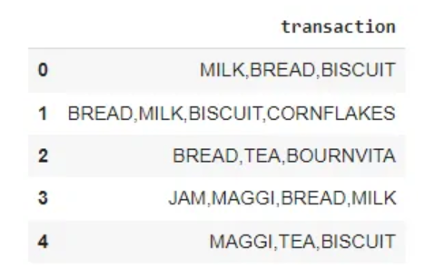
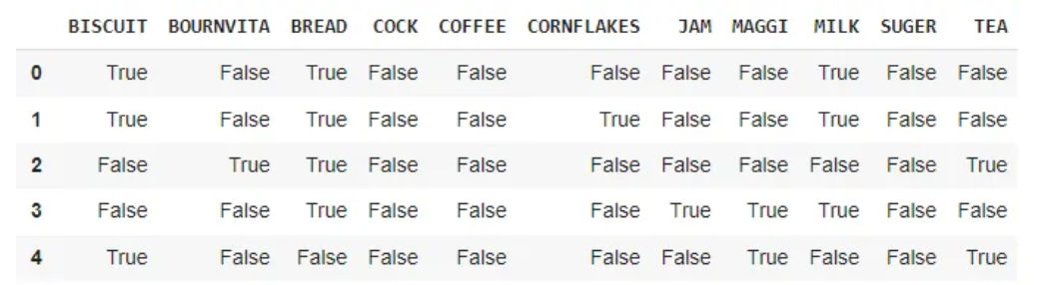
Data Preparation
What are the pre-processing steps would you apply for different types of variables ?
Null Values : For market basket analysis , important columns are products which was bought on each transaction. So there wont be null values .

Slide 10
Data Preparation
Feature Selection
Correlation analysis: This involves analyzing the correlation between products to identify the most commonly purchased products together. Products with a high correlation coefficient can be considered as important features.
Information Gain: This involves calculating the information gain of each product or product category in the dataset. Products with a high information gain can be considered as important features.
Recursive feature elimination (RFE): This involves recursively removing features from the dataset and evaluating the performance of the model. Features that contribute the most to the performance of the model can be considered as important features.

Slide 11
Data Preparation
What Kind of Train-Test Split would you do ?
No, it is not necessary to split data into training and testing sets when doing market basket analysis .Market basket analysis does not build a model. Instead, it finds piecewise of rules of associations (measured in support, confidence, lift and etc.) between items.

Slide 12
Modelling and Deployment
What kind of Model and metrics would you use ?
Apriori Algorithm
Association Rule Algorithm
SETM Algorithm
FP growth
The Apriori algorithm is an efficient and widely used algorithm for mining frequent itemsets and generating association rules, but it may not be the best choice for datasets with a large number of items or transactions. In such cases, algorithm like FP-growth may be more efficient.

Slide 13
Modelling and Deployment
Metrics Used:
Support: Support is the percentage of transactions that contain a particular itemset. It is a measure of how frequently the itemset appears in the dataset.
Confidence: Confidence is the conditional probability that an item Y is purchased given that item X is purchased. It measures the strength of the association between the two items.
Lift: Lift is the ratio of the observed support of an itemset to the expected support of the itemset if the items were independent. It measures the strength of the association between two items while taking into account their individual frequencies.
Conviction: Conviction is a measure that indicates how much more likely it is that an association rule is true compared to if it were simply due to chance.

Slide 14
Challenges
Data quality: The accuracy and completeness of data used for market basket analysis is crucial. If the data is incomplete or contains errors, it can lead to incorrect or unreliable results.
Data volume: Market basket analysis requires large amounts of data in order to identify significant patterns.
Should be careful while choosing the minimum Support threshold . It wont cause problem if the dataset is small, but it could become a bottleneck if you are working with a large dataset. E.g., 1,000 items can create as many as 499,500 item pairs.
Dynamic market: Markets are dynamic and ever-changing, with new products, trends, and customer behaviors emerging all the time. This can make it challenging for businesses to keep up with changes and adjust their strategies accordingly.

